Slide 1
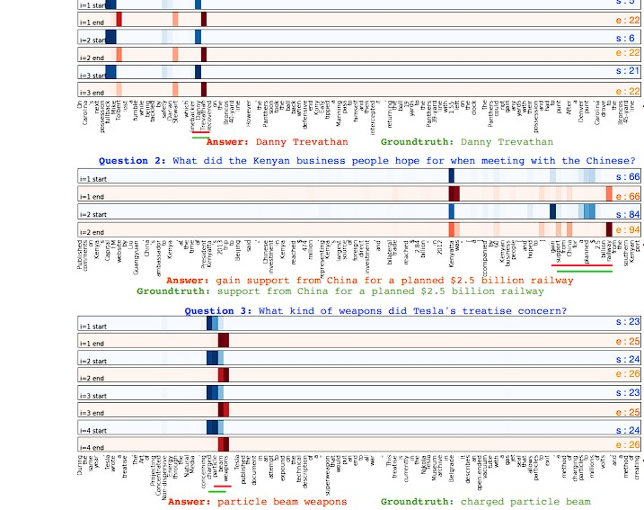
DYNAMIC COATTENTION NETWORKS FOR QUESTION ANSWERING
Presented by
GROUP 12
Aditi Chauhan
Gabriel Haubenburger
Mohammadali Dehghani
Áron Lakatos

Slide 2
Introduction
Paper Overview
Addresses span-based QA on the SQuAD dataset
Identifies limitations of single-pass neural QA models
Focus on recovering from local maxima in answer prediction
Proposed Solution
Introduces the Dynamic Co attention Network (DCN)
Co attention encoder jointly models question–document interactions
Dynamic pointing decoder iteratively predicts start and end positions
Iteration allows correction of incorrect initial answers
Key Contributions
Introduces a co attention mechanism that simultaneously attends to both question and document representations.
Proposes an iterative answer span prediction strategy instead of single-pass decoding.
Demonstrates state-of-the-art performance on SQuAD at the time of publication:
75.9% F1 with a single DCN model
80.4% F1 with a DCN ensemble
Shows that iterative reasoning significantly improves robustness in machine comprehension.

Slide 3
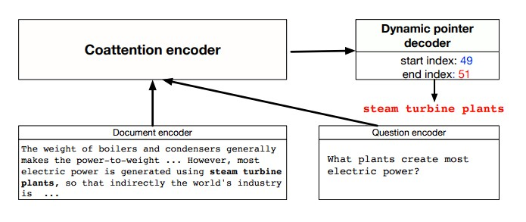
Understanding
Dataset
Evaluated on SQuAD v1.1, a large-scale human-annotated QA dataset
Key Methodological Insights
Coattention captures fine-grained interactions between question and document
Iterative decoding helps escape local maxima
Alternating start–end prediction improves answer span accuracy
Results
Single DCN model: 75.9% F1
DCN ensemble: 80.4% F1
Model Architecture
Coattention Encoder
Learns co-dependent representations by jointly attending to question and document tokens
Dynamic Pointing Decoder
Iteratively predicts start and end positions of the answer span
Allows refinement of predictions across multiple decoding steps.

Slide 4
Reproduction
Models Evaluated on Dev
DCN (baseline)
BERT (warm-start)
DistilBERT
DeBERTa
Evaluation Metrics
Exact Match (EM)
Measures whether the predicted answer exactly matches the gold answer
F1 Score
Measures token-level overlap between prediction and gold answer
Implementation Details
Environment managed using conda (environment.yml)
Experiments executed via PyCharm / Python scripts
Official SQuAD evaluation script used
Inference-only (no model retraining)
Quantitative Results
Model | EM | F1
Single DCN Model (Paper) | 65.4 | 75.6
DCN Ensemble (Paper) | 70.3 | 79.4
DCN (reproduced) | 48.2 | 61.4
BERT | 64.4 | 79.1
DistilBERT | 66.9 | 76.8
DeBERTa (Extension) | 87.46 | 94.04

Slide 5
Side-by-Side Output Comparison (Same Questions – Different Models)
Question | Gold Answer | DCN | BERT | DistilBERT | DeBERTa
Which NFL team represented the AFC at Super Bowl 50? | Denver Broncos | NFL team | Denver Broncos | denver broncos | Denver Broncos
Which NFL team represented the NFC at Super Bowl 50? | Carolina Panthers | NFL team | Carolina Panthers | carolina panthers | Carolina Panthers
On what date was Super Bowl 50 played? | February 7, 2016 | February 7, 2016 | february 7, 2016 | february 7, 2016 | February 7, 2016
Where did Super Bowl 50 take place? | Santa Clara, California | Santa Clara | San Francisco Bay Area at Santa Clara, California | levi's stadium | Levi’s Stadium
What was the theme of Super Bowl 50? | golden anniversary | arabic numerals | golden anniversary | arabic numerals | golden anniversary

Slide 6
Challenges
Category | Main Challenge | Impact
Model Limitations | Old RNN-based architecture with no pretraining | Weak language understanding compared to transformers
Implementation Issues | Implemented in Chainer (deprecated framework) | Hard to run, debug, and integrate with modern tools
Environment Constraints | No GPU and old Python/NumPy versions | Very slow inference and limited experiments
Embedding Mismatch | Wrong GloVe version used at first | Weights mismatch caused very Low EM and F1 scores

Slide 7
Extension
Model Selection: DeBERTa-v3-Large
Disentangled Attention
  Separates content (semantics) and relative position embeddings
  Prevents positional bias
Enhanced Mask Decoder
  Incorporates absolute positional information during decoding
  Better captures syntactic structure
ELECTRA-style Pretraining
  Uses Replaced Token Detection (RTD) instead of MLM
  More sample-efficient and robust contextual learning
Experimental Setup
Sliding Window Strategy
  Max sequence length: 512
  Document stride: 128
  Prevents loss of answer spans in long passages
GPU Optimization
  Batch size: 16
  Improved throughput and GPU utilization
Outcome
DeBERTa-v3-Large significantly outperforms classical QA architectures
Demonstrates the impact of pretraining and attention design on QA performance
Outcomes: Benchmark Performance:
- Exact Match (EM): 87,46%
- F1 Score: 94,04%

Slide 8
Conclusion
Interpretation of Results
DCN often generates incorrect or meaningless outputs, indicating limited language understanding.
BERT and DistilBERT produce mostly correct answers, with small wording differences affecting EMscores.
DeBERTa provides the most precise and consistent answers across different question types.
Key Takeaways
Reproducing older QA models like DCN is difficult and often leads to large performance gaps.
Modern pretrained transformer models clearly outperform classical architectures on SQuAD.
DeBERTa achieves the highest accuracy, while DistilBERT offers a strong balance between speed and performance.

Slide 9
Project Repo
Main repo: https://github.com/AccessRank42/DLNLP-project
Model weights: https://drive.google.com/drive/folders/10YLpWcEBIQhPuEPOJjG5vb2hNW7GUzKs?usp=sharing

